Slide 1
MS and Ataxia
Tim O’Maley
NP – MS / Neuroimmunology
Gold Coast University Hospital

Slide 2
What is Ataxia?
https://youtu.be/eCLp7zodUiI

Slide 3
If your patient walks funny – refer to Physio Thank You for Listening Questions??

Slide 4
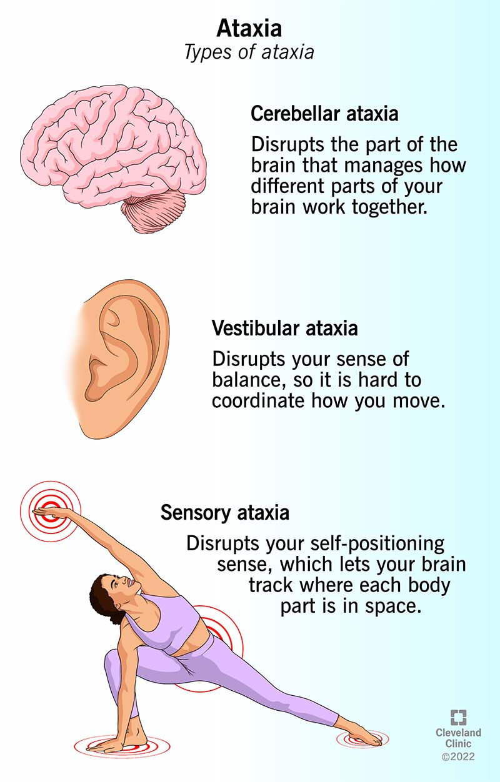
What is Ataxia?
Ataxia is the medical term that describes a lack of muscle coordination anywhere in the body.
In MS this can include symptoms of:
Unsteady Gait
Poor Coordination (of limbs) - Clumsiness
Impaired Limb movements
Impaired eye movements (nystagmus)
Speech – dysarthria / slurred speech / volume / strength of voice
Tremor
Estimates vary, but research suggests as many as 80% people with MS will have ataxia to some degree at some point.
Ref: https://mstrust.org.uk/a-z/ataxia?via%3Dihub

Slide 5
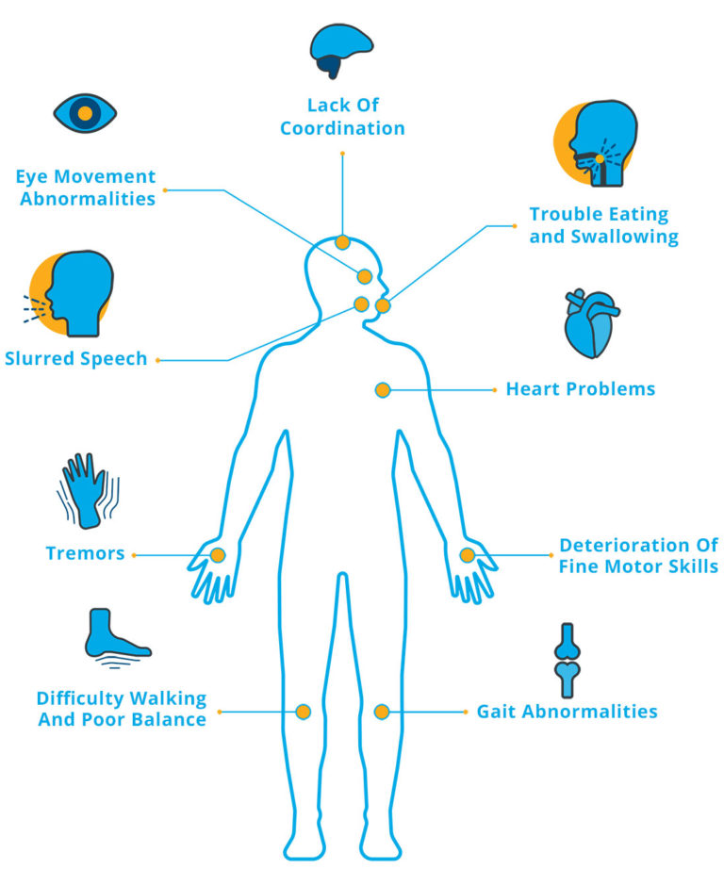
Ataxia as Diagnosis vs a Symptom
Fragile X Ataxia Syndrome
Episodic Ataxia
Sporadic Ataxia
Fredrich’s Ataxia
Mitochondrial Ataxia
Spinocerebellar Ataxia
Multiple System Atrophy
Vitamin B12 deficiency.
Tertiary syphilis.
OR - A symptom of
MS (or PD or Stroke or Head Injury or Alcoholism or……)
https://www.ucsf.edu/news/2011/08/103868/major-genetic-study-multiple-sclerosis-reveals-dna-hot-spots-disease

Slide 6
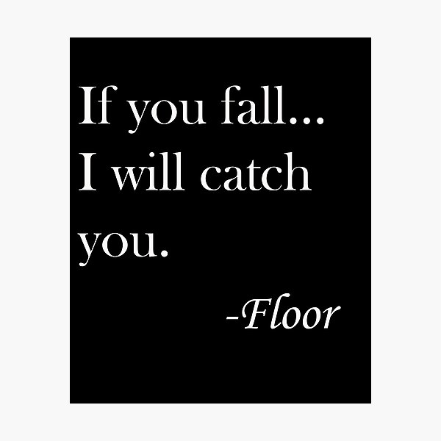
What is Ataxia?
Cerebellar Ataxia occurs when there’s damage to the part of the brain that looks after coordination and motor control.
This can cause muscle flaccidity / weakness, lack of coordination and an inability to control power and speed of movement.
Ref: https://www.msaustralia.org.au/symptom/ataxia/?via%3Dihub

Slide 7
What is Ataxia?
Sensory Ataxia - damage to the sensory pathways that control the messaging between the brain / spinal cord and the limbs.
This interferes with the person’s ability to know where the parts of the body are in relation to each other and to their surroundings (proprioception).
Eg: ‘stomping walk’ -cannot judge where their legs are in relation to the ground.
Reduced vibration sense
Poor ‘touch your nose’ – eyes closed
Ref: https://www.msaustralia.org.au/symptom/ataxia/?via%3Dihub

Slide 8
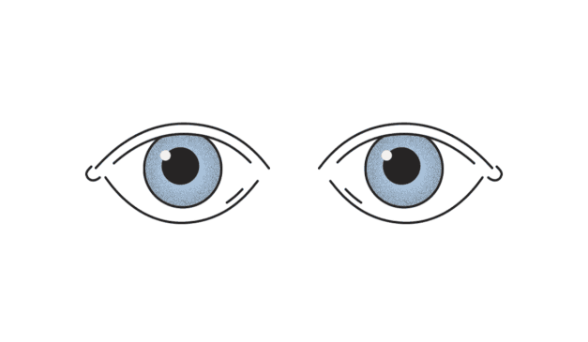
What is Ataxia?
Vestibular Ataxia occurs when there’s damage to the cranial nerve(s) and the person may experience vertigo & / or imbalance.
Veer to the ipsilateral side
Nystagmus is common in people with VA
- can be monocular or binocular
+/- N&V
OR – just a ‘simple’ ear problem
Ref: https://www.msaustralia.org.au/symptom/ataxia/?via%3Dihub

Slide 9
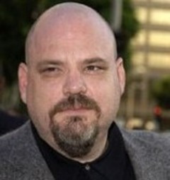
It’s all in the Eyes (but not really)
Nystagmus
uncontrollable eye movement- usually a repetitive cycle of slow movement in a specific direction followed by a quick adjustment back to center.
The vestibulo-ocular reflex.
Saccades – Smooth Pursuit
Saccades are rapid eye movements that allow us to quickly scan a visual scene. The eye focuses on a position for only a brief moment, before quickly jumping to the next.
Follow my finger
Look L – Look R
Sensory
Ref: https://my.clevelandclinic.org/health/symptoms/17748-ataxia3Dihub

Slide 10
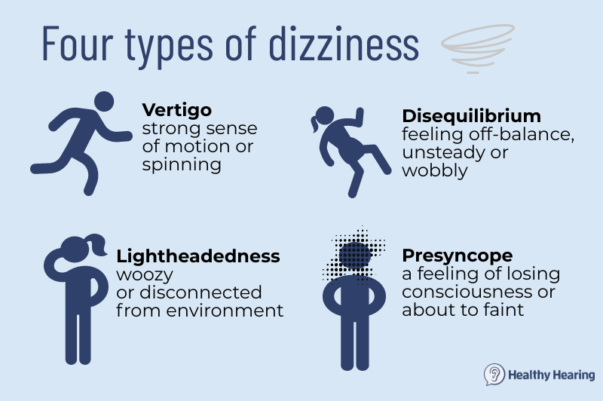
Vertigo v’s Dizziness
Dizziness
Common (MS) Symptom BUT also has many other
possible causes
- BPPV / Tumor / Cardio-Vascular / Migraine / Infection
Vertigo
sensation that surroundings are spinning. These symptoms are due to lesions — damaged areas — in the complex pathways that coordinate visual, spatial and other input to the brain needed to produce and maintain equilibrium
Refs: https://www.nationalmssociety.org/Symptoms-Diagnosis/MS-Symptoms/Dizziness-and-Vertigo#
https://www.healthyhearing.com/help/tinnitus/dizziness-and-hearing-loss

Slide 11
The ‘Simple’ Romberg’s Test
The test is named after European neurologist, Mortiz Romberg, who came up with the tool in the 19th century to diagnose tertiary (late) syphilis.
Stand
Feet Together
Eyes Open
Eyes Closed
Looking for ‘sway’
Positive – Eyes Closed
The fakers won’t fall
Does have 1 limitation
How does balance work?
Balance is the ability to remain upright and move steadily by having even distribution of your body’s weight. Your body normally maintains balance through a complex combination of sensorimotor control systems that include:
Sensory input from vision (sight).
Proprioception (your body’s ability to sense your movements and position).
The vestibular system in your inner ear (motion, equilibrium and spatial orientation).
Proper incorporation of that sensory input.
Motor (motion) output to your eyes and muscles.
Ref: https://my.clevelandclinic.org/health/diagnostics/22901-romberg-test

Slide 12
Assessments / Rating Scales – Nurses Can and Should!
SARA
ICARS

Slide 13
Treatment – Cochrane Review (2007)
Exercise / Yoga / Pilates – Physical Therapy – only thing that really works
Tremor - Isoniazid and pyridoxine versus placebo – NO Benefit
Tremor - Cannabis based medicine versus placebo - NO Benefit (improved MH / QoL)
Postural Stability - Baclofen versus placebo - NO Benefit
Tremor - Thalamotomy versus deep brain stimulation - NO Benefit (@6 months – return to baseline)
Ref: https://www.cochranelibrary.com/cdsr/doi/10.1002/14651858.CD005029.pub2/full

Slide 14
Treatment
Treatment for ataxia depends on the cause, but usually involves a combination of rehabilitation and compensatory strategies.
Adaptive devices, such as walkers or canes, may help maintain independence.
Physiotherapy, Occupational Therapy, Speech Therapy
Regular aerobic exercise may help by developing compensatory strategies and doing activities that challenge your sense of balance and coordination.
Ref: https://www.msaustralia.org.au/symptom/ataxia/

Slide 15
Treatment
Exercise / Yoga / Pilates
Walking Aides – SPS / Crutch / Walker / Trekking Poles
Weights
Braces
Lycra / Neoprene
Tubigrip
Visual Training – placing items in peripheral not central visual fields.
Sensory – tactile eg stick on hook and loop on a brush or mug
Posture Training
Ref: https://mstrust.org.uk/a-z/ataxia - has an excellent video that goes through all of these

Slide 16
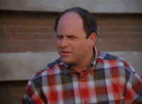
Nurse to Patient – Assess + Educate + Repeat
Safety – falls / burns / knife through hand /foot / knife through child
Aides / modifications
Simple exercises – sit to stand / balance training
Alcohol / Drugs / Medications
Driving
Vision
Coordination
Power
Neuroplasticity – activity / exercise – Physio / OT / Speech
Yoga / Pilates / Kung Fu / Tia Chi

Slide 17
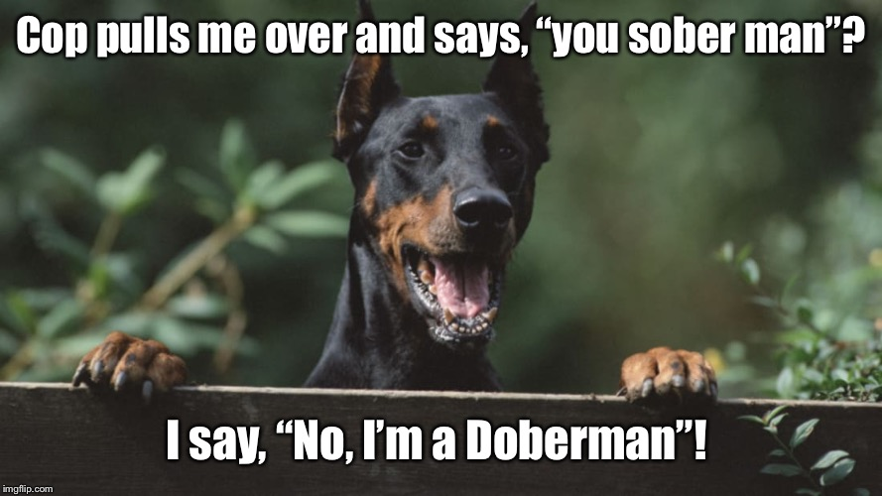
Thank You for Listening Questions??

